Slide 1




Interdisciplinary Centre for Security, Reliability and Trust
Signal Processing Applications in Radar and Communications
Waveform Design in Modern Radar Systems
Bhavani Shankar M. R
16 April 2026
Hosted by:
SPARC Research Group
Centre for Networked Intelligence, IISc

Slide 2


Acknowledgements
Colleagues at SPARC
Collaborators at IEE

Slide 3

Outline
Modern Radar Systems
Applications, Requirements and Degrees of Freedom
SISO Radar Waveform Design
Waveform Properties, Ambiguity functions, Design Objectives
Waveform Optimization Methodologies
Examples
PMCW
Quadratic Phase waveforms for interference mitigation
Principle of Stationary Phase
MIMO Waveforms
Orthogonality
Extension of SISO design
ISBN: 9781630818920
Artech House, 2022

Slide 4
Outline
Modern Radar Systems
SISO Radar Waveform Design
Examples
MIMO Radar Waveforms

Slide 5
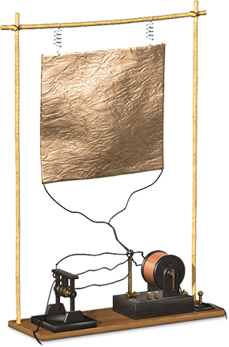
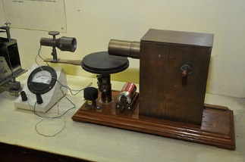
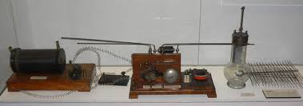
The Radar Origins
Heinrich Hertz : Experimental proof of existence of Electromagnetic waves
Fundamental contribution, series of developments
mmWave generation, influencing radio as communication medium – J. C. Bose
Radio transmissions – Marconi
Telemobiloscope – Radio waves for detection/ ranging – Hulsmayer
Notes:
NEED TO MAKE IT MORE COLORFUL

Slide 6
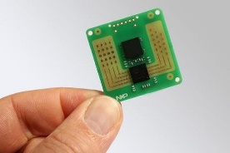
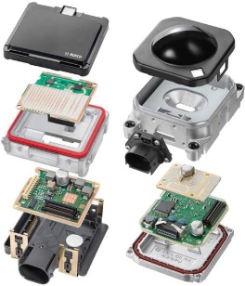
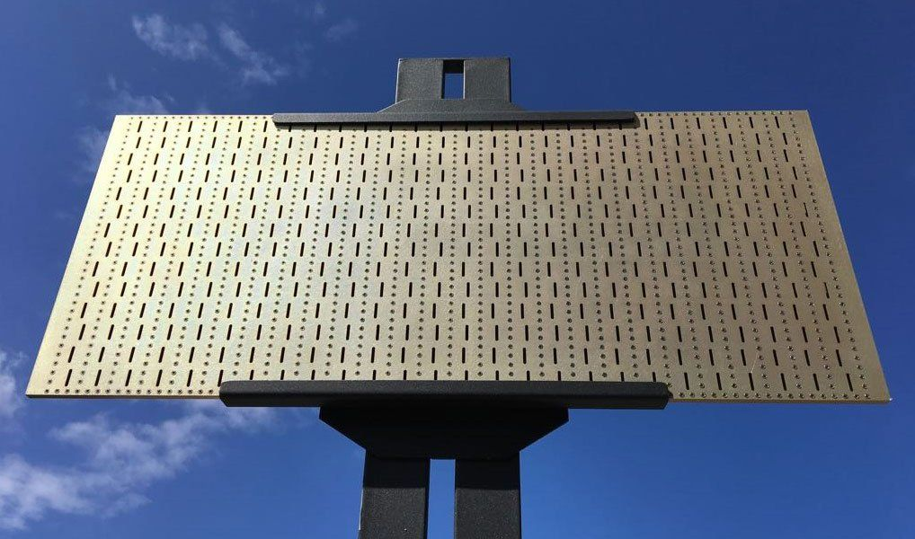
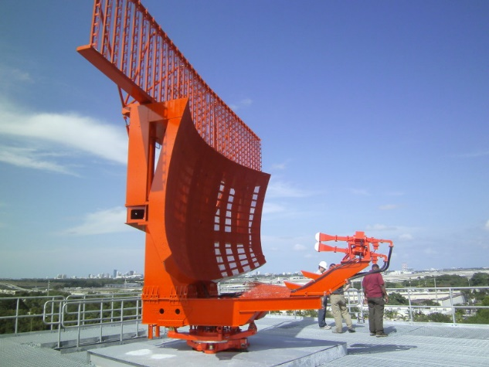
The Radar Evolution
Metric waves to mmWave and THz
Capabilities
Size
Cost

Slide 7
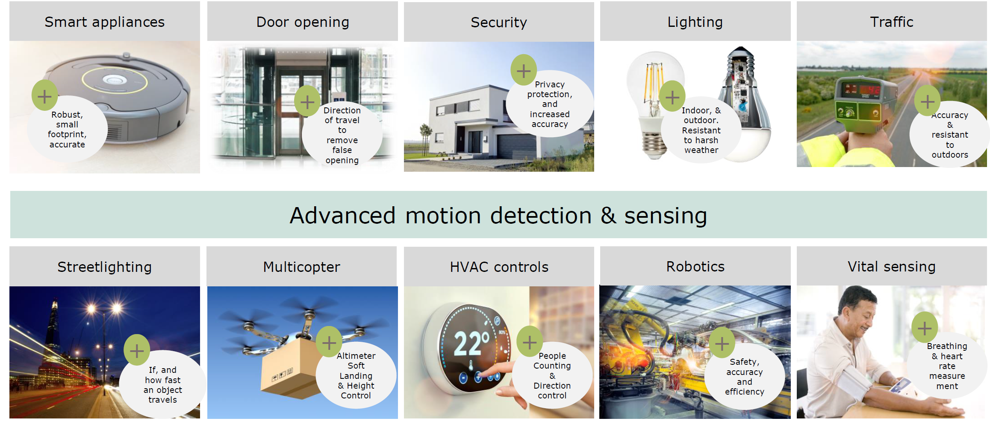
Modern Radar Systems

Slide 8
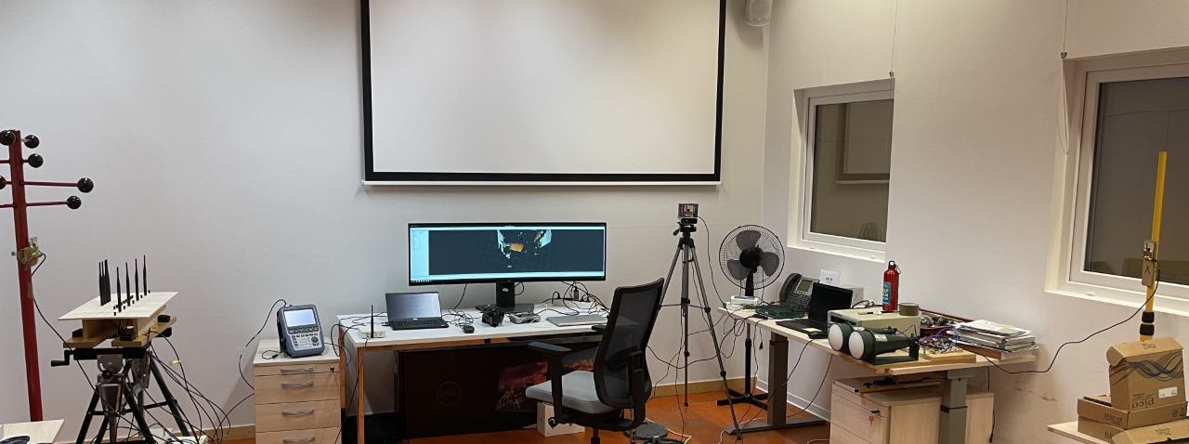
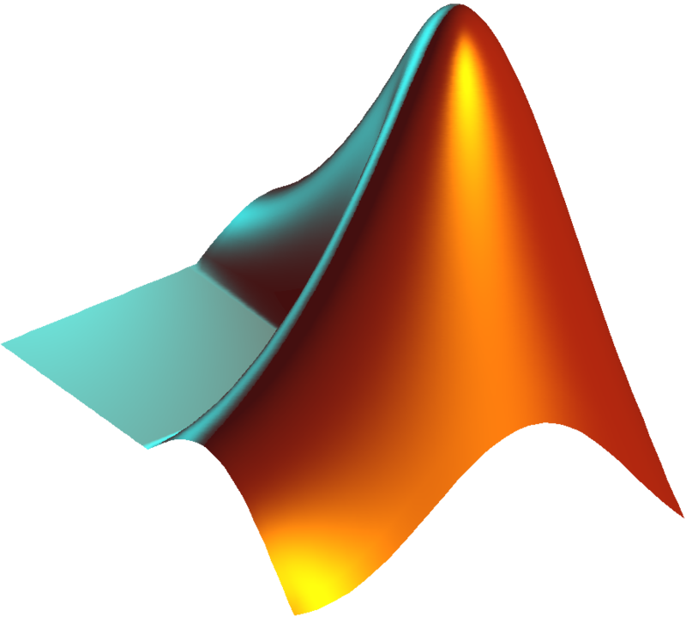

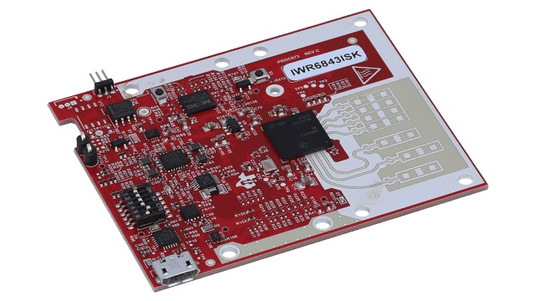
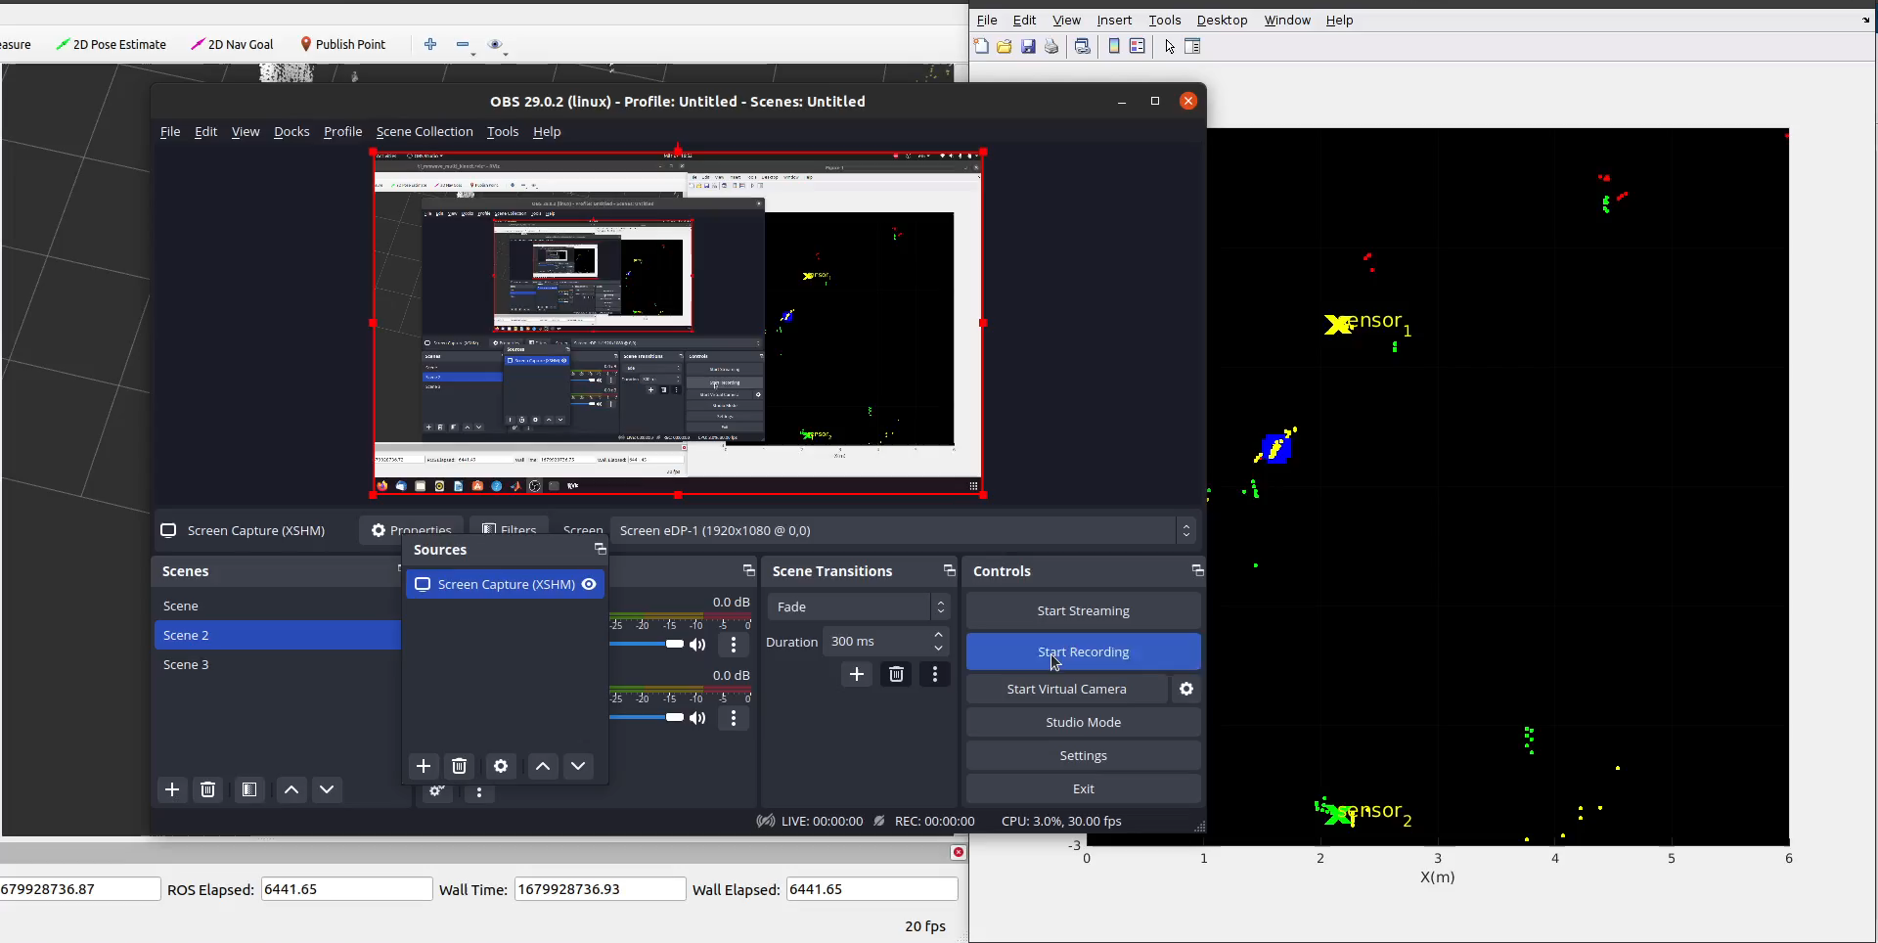






Distributed Radar System
Connection
Reference sensor and camera
$$S_{0}$$
$$S_{1}$$
$$S_{2}$$
Sensor 2
Point cloud display
Sensor 1
$$Z_{0}$$
$$Z_{1}$$
$$Z_{2}$$

Slide 9
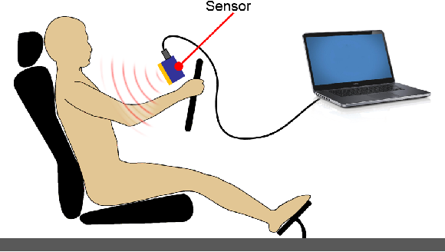
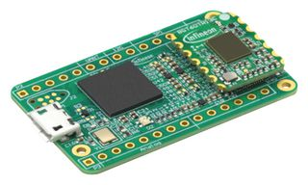
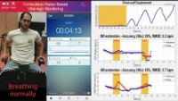
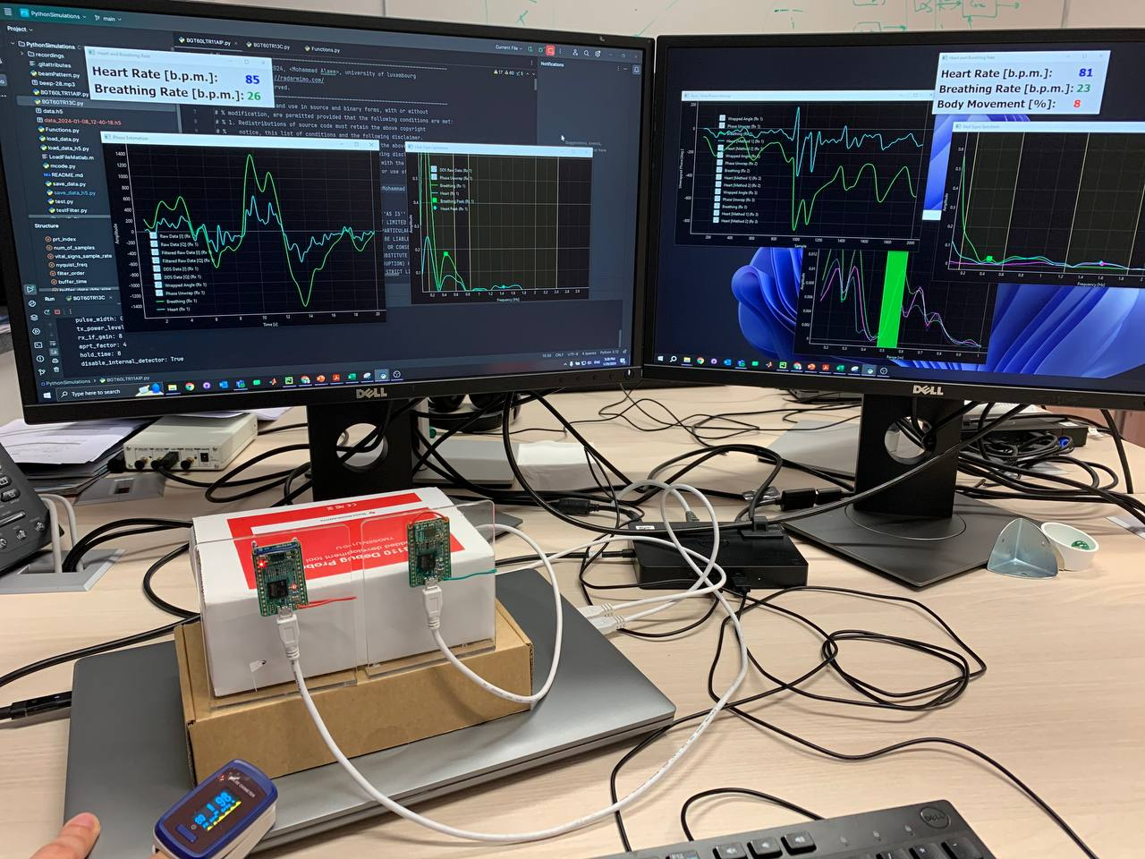

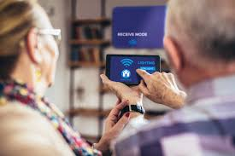
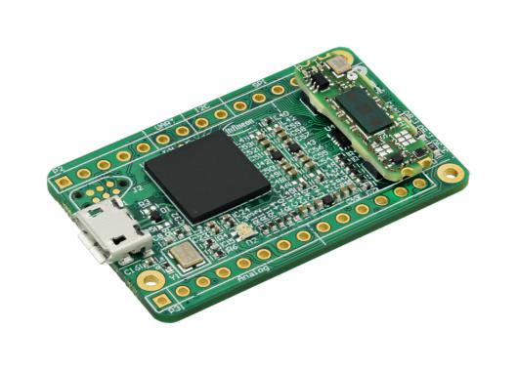
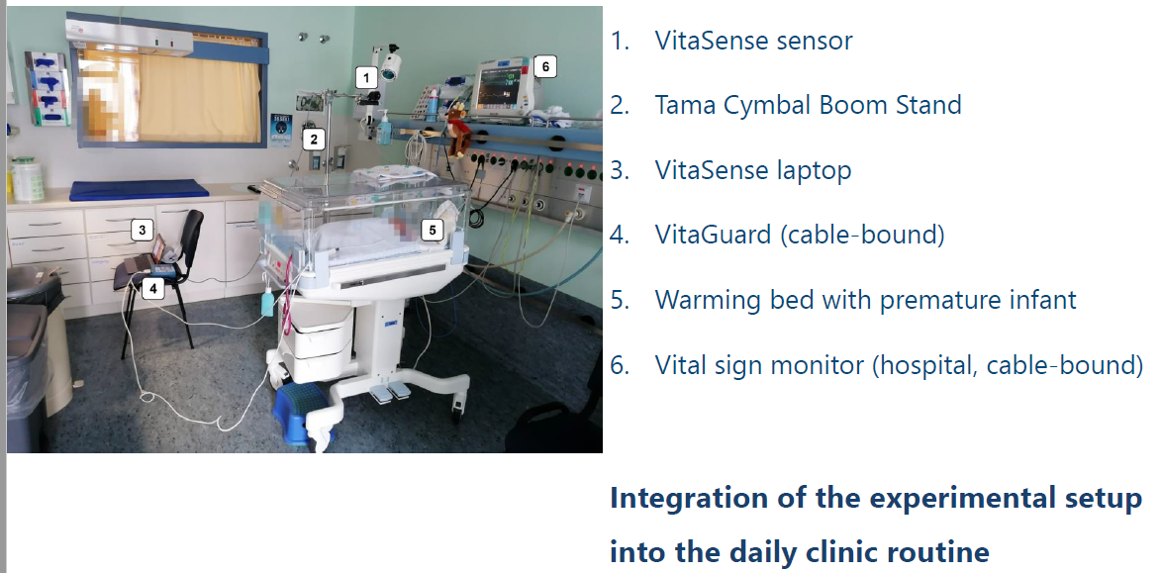

Vital Sign Monitoring
Breathing, Heartbeat estimation
Heartrate variability
Applications
Neonatal care monitoring
In-cabin monitoring
Assisted living technologies
Security
“Search-and-Rescue”
Heart Rate: 80 b.p.m
Data Collection
Department of General Pediatrics and Neonatology, Saarland University Medical School,
Homburg, Germany.

Slide 10
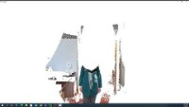
Multi-modal Fusion
Radar
Can measure range/speed
Can see through medium
Not affected by weather
Lidar
Can generate high resolution 3D points
Sensitive to weather
Cannot see through medium
Limited range
Why not combine both for a system that is bigger than the sum of their parts?

Slide 11
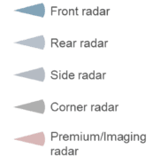
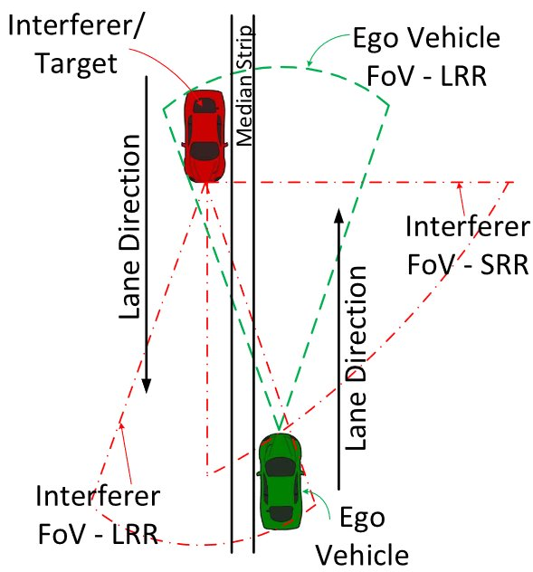
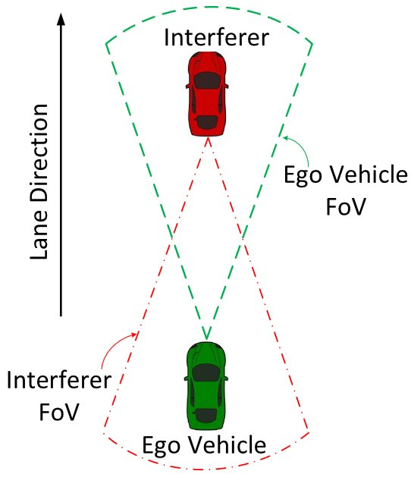
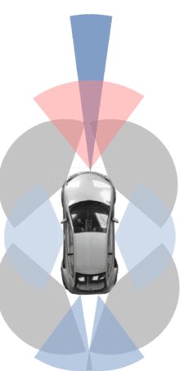
A brief digression with multiple sensors
Un co-ordinated transmissions: Interference in Roadside scenarios
Oncoming Traffic
Cruise Control

Slide 12
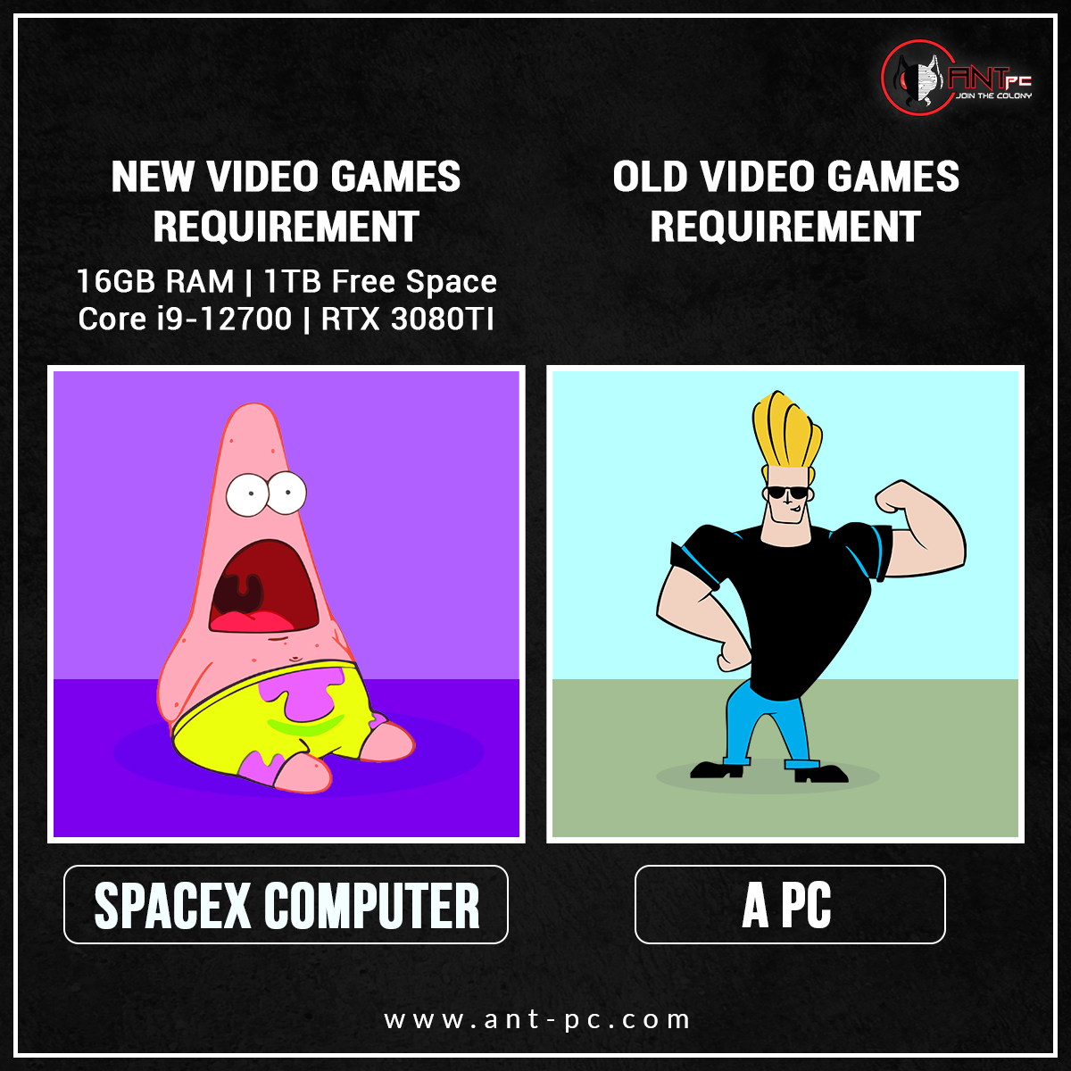
New Scenarios, Challenges and DoF
Short(er) Range
Many non-stationary Targets
High Resolution
Multiple and potentially un co-ordinated
© Ant PC Systems
Available Degrees of Freedom
Multiple antennas and Waveform Diversity
Multiple sensors and Spatial Diversity
Receiver Processing Algorithms

Slide 13
Outline
Modern Radar Systems
SISO Radar Waveform Design
Examples
MIMO Radar Waveforms

Slide 14
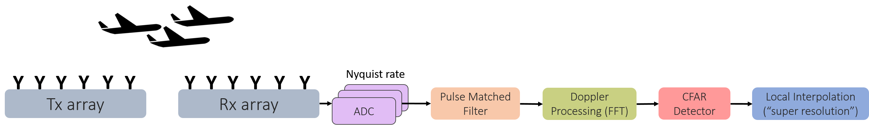
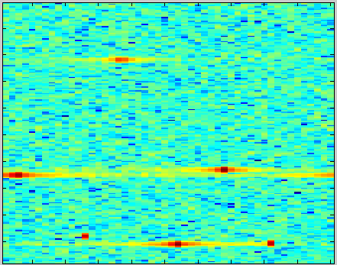
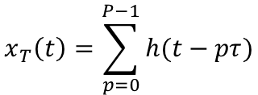
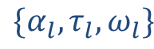
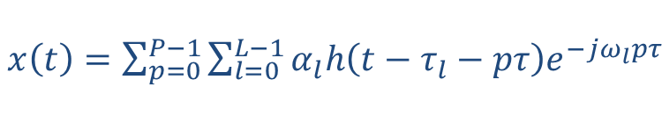
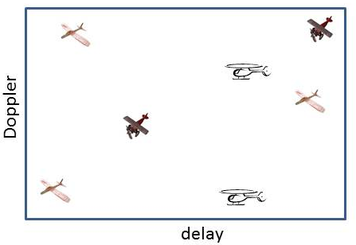

Classical Pulse Doppler Radar Processing
Electromagnetic wave is characterized by amplitude, frequency, and polarization
When an incident wave interacts with the object of interest, all these properties change
Single antenna transmit pulse train:
Reflections from L targets, each defined by
Received signal:
Design Trade-Offs
High range resolution requires short time transmissions/ large signal bandwidths
High Doppler resolution requires long dwell times
High angular resolution is achieved with more antenna element
Delay-Doppler map
Doppler
Reflectivity
Range-time

Slide 15





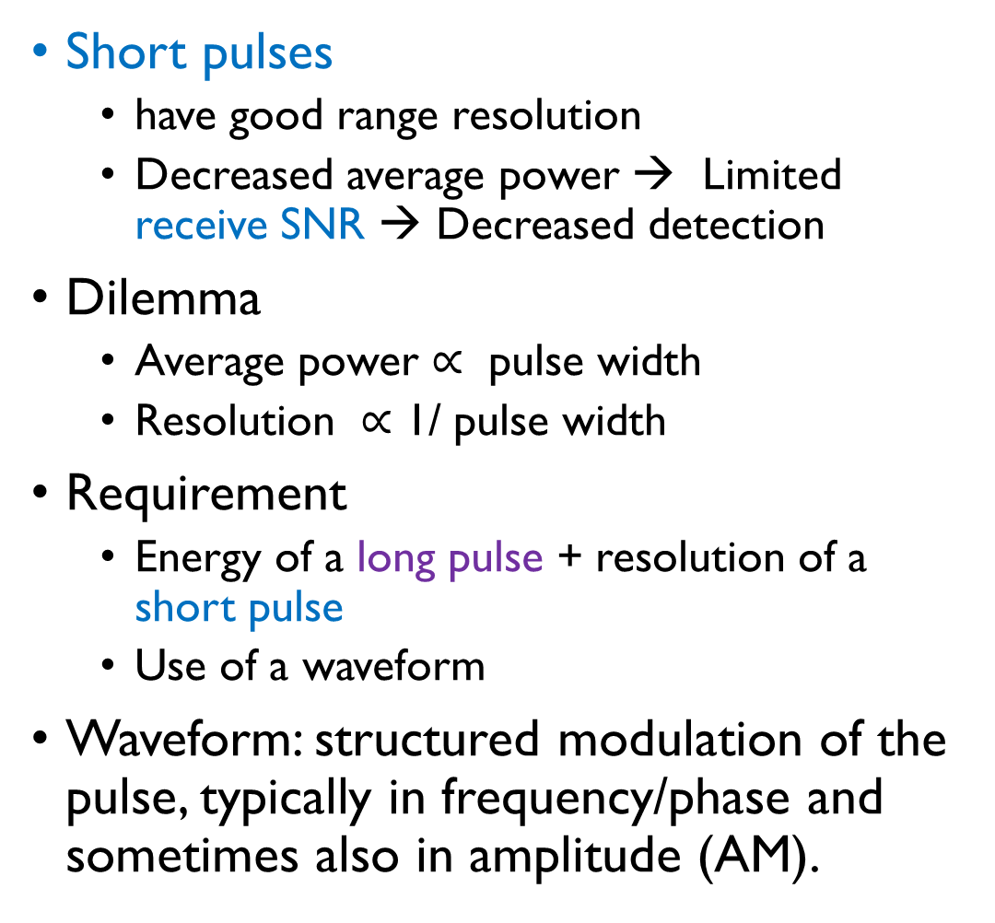







Linear Frequency Modulated Waveform
Waveforms
Square Pulse
Short pulses
have good range resolution
Decreased average power → Limited receive SNR → Decreased detection
Dilemma
Average power $∝$ pulse width
Resolution $∝$ 1/ pulse width
Requirement
Energy of a long pulse + resolution of a short pulse
Use of a waveform
Waveform: structured modulation of the pulse, typically in frequency/phase and sometimes also in amplitude (AM).
Pulse Width, $T$
Pulse Width, $T$
Bandwidth = $\frac{1}{T}$
Frequency $F_{1}$
Frequency $F_{2}$
Time × Bandwidth = $1$
Bandwidth = $ΔF=F_{2} −F_{1}$
Time × Bandwidth = $T×ΔF$
Phase Coded Waveform
Pulse Width, $T$
Bandwidth = $\frac{1}{T_{chip}}$
Time × Bandwidth = $\frac{T}{T_{chip}}$
$$T_{chip}$$

Slide 16

Ambiguity Functions
Ambiguity function contains information on:
range resolution
range sidelobe level
range ambiguity spacing
Doppler resolution
Doppler sidelobe level
Doppler ambiguity spacing
Ideal ambiguity function : thumbtack –
i.e. an infinitely-narrow spike at the origin
infinitely-high resolution in range and Doppler
no sidelobes, and no ambiguities
$s\left(t\right):$ Transmitted Waveform
$r\left(t\right):$Received Waveform
$r\left(t\right)=s\left(t\right)e^{j2πf_{D}t}$
Receiver filter : $h\left(t\right)=s^{∗}\left(−t\right)$
Output of the receiver filter at time
$$χ\left(τ, f_{D}\right)=∫r\left(t\right)h^{∗}\left(τ−t\right) dt$$
$χ\left(τ, f_{D}\right)=∫s\left(t\right)s^{∗}\left(t−τ\right)e^{j2πf_{D}t}dt$
Ambiguity Function

Slide 17
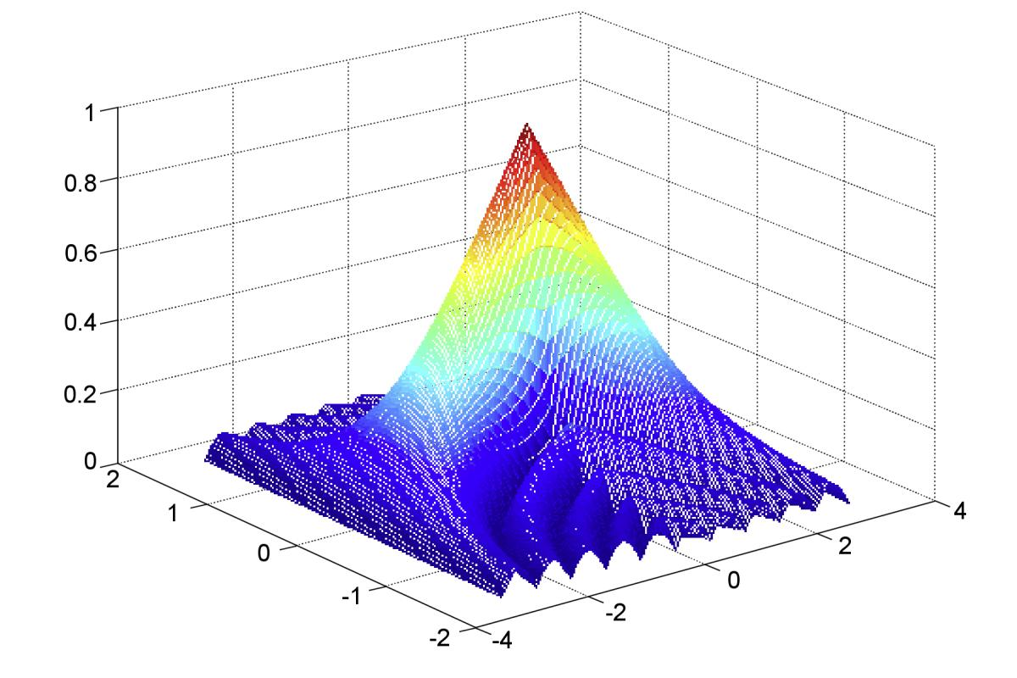
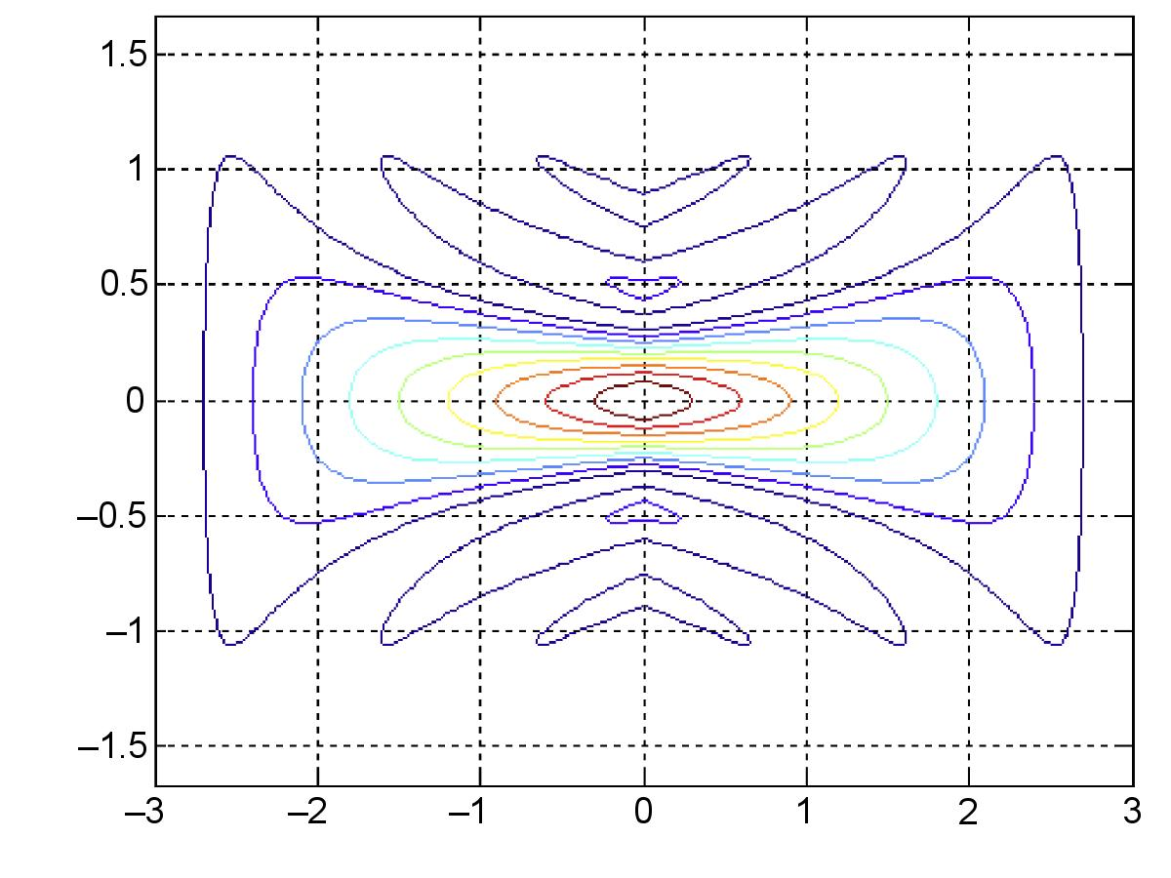
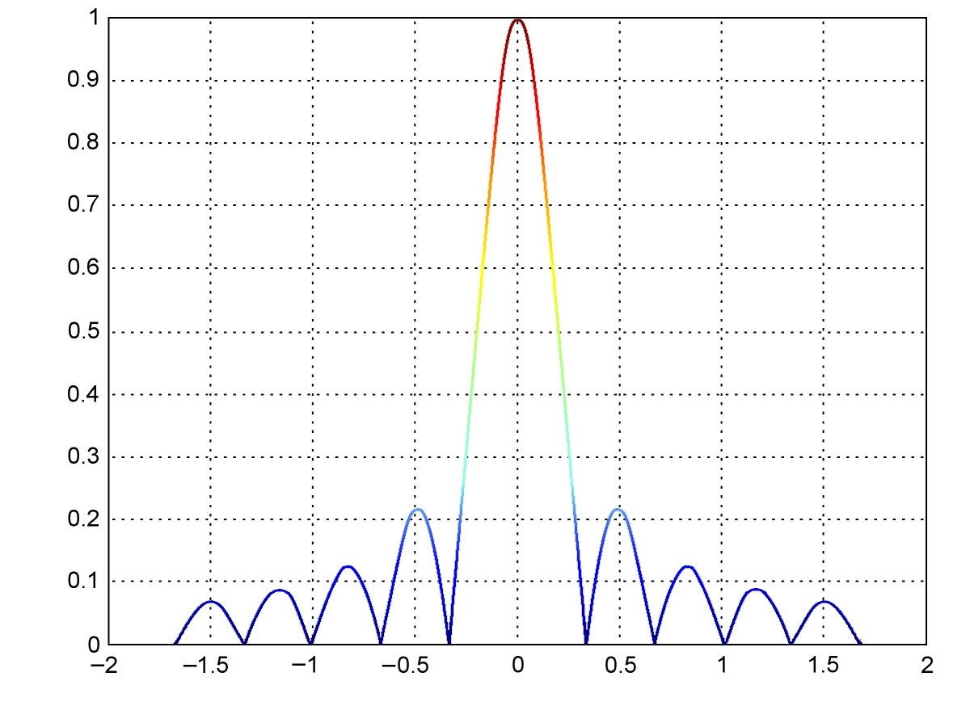
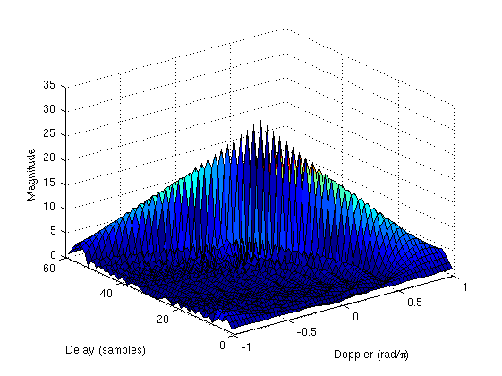
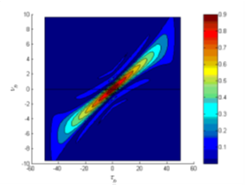
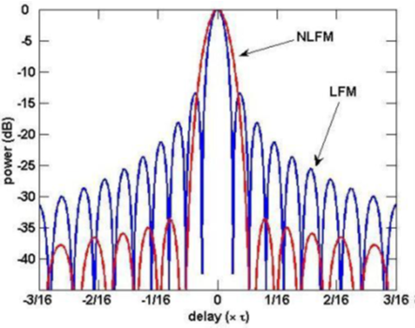


Ambiguity Functions
© Radartutorial, Pics from internet
Square pulse
$$s\left(t\right)=1, 0≤t≤T$$
FMCW
$$s\left(t\right)=A e^{j2π( f_{c}t+ μt^{2})}, 0≤t≤T$$

Slide 18
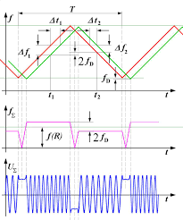
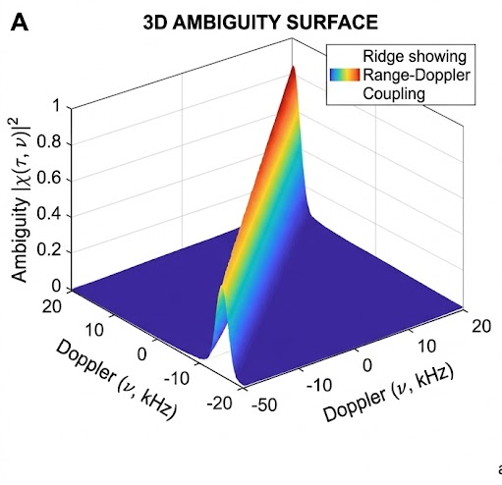


© Radartutorial, Pics from internet
Ambiguity Functions of FMCW
$$s\left(t\right)=A e^{j2π( f_{c}t+ μt^{2})}, 0≤t≤T$$

Slide 19
Ambiguity Functions
Smaller main lobe
High sidelobes in range, 13 dB peak side lobe
Reminiscent of rectangular pulse
Classical method to reduce side lobes
Windowing at receive side
Mismatched Filter – SNR loss
Amplitude Modulation at the transmit
Widowing at transmit
Amplifier inefficiency

Slide 20
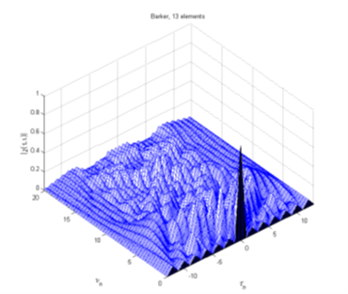
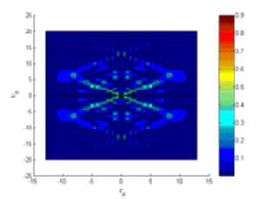
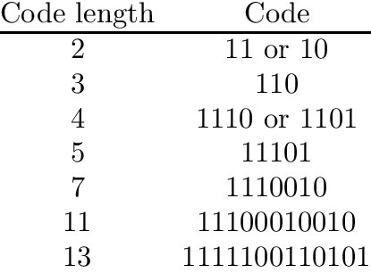
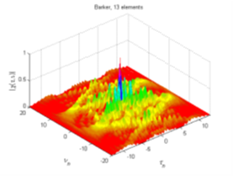



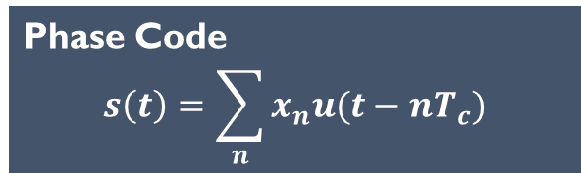



Ambiguity Functions
© Radartutorial, Pics from internet
Phase Code
$$s\left(t\right)=\sum_{n}{x_{n}u(t−nT_{c})}$$
$$x_{0}$$
$$x_{1}$$
$$x_{2}$$
$$x_{N−1}$$
$$T_{c}$$
M- length Barker Code:
Max Peak Side Lobe $≤$ Main lobe/ M
© A generalized multivariate Student-t mixture model for Bayesian classification and clustering of radar waveforms (researchgate.net)

Slide 21
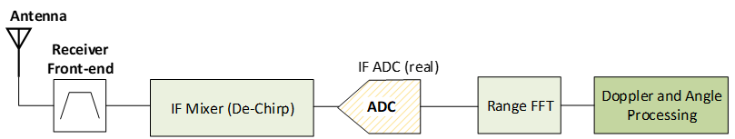
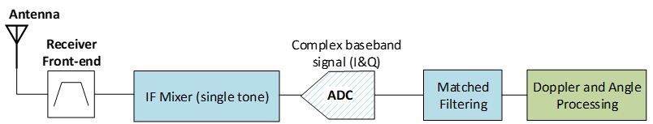
FMCW or PMCW?
FMCW radars sample @ few MHz
e.g : 16.7 Msps
Highly popular
FMCW
PMCW
PMCW radars sample @ BW
e.g : 275 Msps
Performance of both are largely similar
PMCW offers additional degrees of freedom

Slide 22


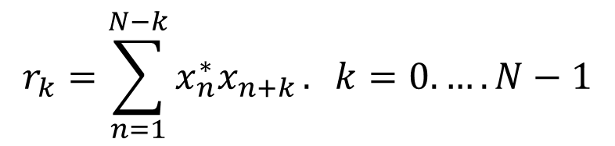

Waveform Design Problems
Quantity | Mathematical Expression
Phase Code
Aperiodic Autocorrelation
PSL
ISL
Constraints
Energy
Peak-to-Average Power Ratio (PAPR, PAR)
Unimodularity (being Constant-Modulus)
Finite or Discrete-Alphabet (integer, binary, m-ary constellation)
…
$$x={\left[x_{1},x_{2}, ….,x_{N}\right]}^{T}$$
$$r_{k}=\sum_{n=1}^{N−k}{x_{n}^{∗}x_{n+k}}. k=0. …. N−1$$
$$\max_{k≠0}\left|r_{k}\right|$$
$$\sum_{k=1}^{N−1}{r_{k}^{2}}$$

Slide 23
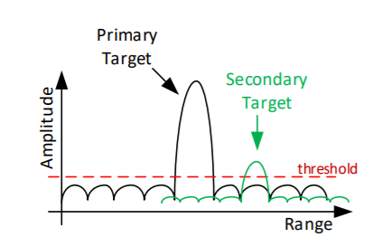



Waveform Design Objectives
Peak Sidelobe Level (PSL)
mitigate the deleterious effects of distributed clutter echoes which are close to the target of interest
PSL
Small
ISL
avoid masking of weak targets in range sidelobes of a strong return
Integrated Sidelobe Level (ISL)

Slide 24


Waveform Design Problems
$$𝒫_{x}\left\{\begin{aligned}&\underset{x}{minimize} \sum_{k=1}^{N−1}{r_{k}^{2}} \\ &subject to x_{n}∈ψ_{n}\end{aligned}\right.$$
$$𝒫_{x}\left\{\begin{aligned}&\underset{x}{minimize} \max_{k≠0}\left|r_{k}\right| \\ &subject to x_{n}∈ψ_{n}\end{aligned}\right.$$
ISL Minimization
PSL Minimization
Many of these problems are shown to be NP-hard, others are deemed to be difficult
How to handle these problems in good time?

Slide 25
Waveform Optimization techniques
Gradient-Descent Based Methods (GD)
Majorization-Minimization (MM)
Coordinate Descent (CD)
Alternating Direction Method of Multipliers (ADMM)
Block Successive Upper-bound Minimization (BSUM)
Several others ...
Notes:
Time-Staggered FMCW Waveform: More efficient than alternative transmitting

Slide 26
Outline
Modern Radar Systems
SISO Radar Waveform Design
Examples
MIMO Radar Waveforms

Slide 27
Waveform Design in an automotive setting
Un co-ordinated transmissions: Interference in Roadside scenarios
Oncoming Traffic
Cruise Control

Slide 28

FMCW and interference
Notes:
Which Scenario

Slide 29


Example 1 : Waveform Design Based Approach
Key Idea
Divide a PMCW sequence into subsequences
Each radar could use its own subsequence lengths
Devise polynomial phase in each subsequence
Different radars can use different phases
Notes:
Which Scenario

Slide 30






Problem Statement
Solved using Majorization-minimization (MM) framework
Let the sequence X be partitioned into L sub-sequences
Every sub-sequence has a length Ml where l = 1,..,L
Every sub-sequence is expressed as
Polynomial phase behavior in every sub-sequence:
is the Q^{th} degree polynomial phase coefficients of the l^{th} sub-sequence
*Integrated/Peak Sidelobe Level (ISL/PSL)

Slide 31


Interference Robustness
Statistical Interference Analysis
Notes:
Statistical Inteference Analysis

Slide 32




USRP Setup

Slide 33

Parameter Settings and setup
Table: Radar sensor parameters for victim and interferer sensor
Calculate SINR of the known target
Victim radar operates with an interferer in FoV
Proposed waveform compared with LFM in every transmit pulse
Receive signal from the target and the interferer was independently digitally delayed in software
Experiment was conducted in a controlled environment in an anechoic chamber

Slide 34





Results – Category 1: LFM (victim) <-> LFM (Interferer)
Victim waveform†
Received signal
Range profile
Interferer waveform
Dechirp signal

Slide 35





Results – Category 2: PECS (victim) <-> LFM (Interferer)
Victim waveform
Received signal
Range profile
Interferer waveform†
Dechirp signal

Slide 36





Results – Category 3: Optimized (victim) <-> Optimized (Interferer)
Victim waveform†
Received signal
Range profile
Interferer waveform†
Dechirp signal

Slide 37


Example 2 : Parametric NLFM
Key Idea
Want to have a certain shape in time domain
Want to have certain shape in the spectrum
Can both be possible?
Spectrum
$$S\left(f\right)=\left|S\left(f\right)\right|e^{jθ(f)}$$
Time-Domain via inverse Fourier
$$s\left(t\right)=\left|s\left(t\right)\right|e^{jψ\left(t\right)}$$
$$s\left(t\right)=\int_{−∞}^{∞}{\left|S\left(f\right)\right|⋅\exp\left(j \left[θ\left(f\right)+2πft\right]\right) df}$$
Can we design $s\left(t\right)$ with constraints on $\left|S\left(f\right)\right|$ and $\left|s(t)\right|$
Spectrum
$${\left|S\left(f\right)\right|}^{2}=\frac{1}{g_{0}B}⋅\sum_{k=0}^{K−1}{g_{k}\cos\left(2πk\frac{f}{B}\right) }, f∈\left[−\frac{B}{2},\frac{B}{2}\right]$$
Time-Domain via inverse Fourier
$$s\left(t\right)=\int_{−∞}^{∞}{\left|S\left(f\right)\right|⋅\exp\left(j \left[θ\left(f\right)+2πft\right]\right) df}$$

Slide 38

Example 2 : Parametric NLFM
Key Idea
Want to have a certain shape in time domain
Want to have certain shape in the spectrum
Can both be possible?
Spectrum
$${\left|S\left(f\right)\right|}^{2}=\frac{1}{g_{0}B}⋅\sum_{k=0}^{K−1}{g_{k}\cos\left(2πk\frac{f}{B}\right) }, f∈\left[−\frac{B}{2},\frac{B}{2}\right]$$
Time-Domain via inverse Fourier
$$s\left(t\right)=\int_{−∞}^{∞}{\left|S\left(f\right)\right|⋅\exp\left(j \left[θ\left(f\right)+2πft\right]\right) df}$$
M. Follmann, M. Alaee-Kerahroodi, B. S. M. R, V. Lücken and A. R. Diewald, "Accuracy Estimation of Window-Based Nonlinear Frequency-Modulated Waveforms," in IEEE Transactions on Radar Systems, vol. 3, pp. 1287-1297, 2025, doi: 10.1109/TRS.2025.3606111

Slide 39
Important Regions of Integration of Oscillating Function
Approximate around this point

Slide 40


The Principle
Stationary Phase
$\frac{d}{df}\left[θ\left(f\right)+2πft\right]=0⇒2πt=−θ^{′}\left(λ\right), λ$is some solution
Taylor Expansion
$$\left|s\left(t\right)\right|=\sqrt{2π} \frac{|S\left(λ\right)|}{\sqrt{|θ^{′′}\left(λ\right)}}$$
After manipulations
$${\left|s\left(t\right)\right|}^{2}dt={\left|S\left(λ\right)\right|}^{2}df$$
Integrations
$$P\left(t\right)=Q\left(λ\right)⇒t=P^{−1}[Q\left(λ\right)]$$
$$θ^{′}\left(λ\right)=−P^{−1}[Q\left(λ\right)]$$
Frequency domain phase
$$θ\left(f\right)=−∫2πP^{−1}\left[Q\left(f\right)\right]df$$
Time-domain phase
$$φ\left(t\right)=−∫2πQ^{−1}\left[P\left(t\right)\right]dt$$
E. Fowle, “The design of FM pulse compression signals,” IEEE Trans.
Inf. Theory, vol. IT-10, no. 1, pp. 61–67, Jan. 1964.

Slide 41
Instantaneous Frequency of Different Window Function Waveforms
Endpoints

Slide 42


Designed Waveform
Final Time-Domain Formulation
$$s\left(t\right)=\frac{1}{\sqrt{T}}⋅rect\left(\frac{t}{T}\right)\exp\left(j\left\{π\frac{B}{T}t^{2}+T\sum_{n=1}^{N}{\frac{a_{n}}{n}\sin\left(2πn\frac{t}{T}\right)}\right\}\right)$$
Waveform Parameters:
$$a_{n}=\frac{1}{π^{2}n}\int_{0}^{π}{\cos\left(\frac{n}{g_{0}}\sum_{k=0}^{K−1}{\frac{g_{k}}{k}⋅\sin\left(kz\right)}\right)dz}$$
$s(t)$: Time-Domain Waveform
$T$: Pulse Duration
$B$: Bandwidth
$a_{n}$: Fourier Parameters
$g_{k}$: Window Parameters

Slide 43


K=2 parameters
$W_{2}(f)$: Window Function
$B$: Bandwidth
$g_{k}$: Window Parameters
$a_{n}$: Waveform Parameters
$J_{ν}\left(z\right)$: First order Bessel Funciton
Spectral Domain
$${\left|S\left(f\right)\right|}^{2}=\frac{1}{B}+\frac{g_{1}}{g_{0}B}⋅\cos\left(2π\frac{f}{B}\right)$$
Waveform Parameters
$$a_{n}=\frac{1}{πn^{2}}\int_{0}^{π}{\cos\left({\left.n\frac{\sin\left(kz\right)}{k}\right|}_{k=0} +n\frac{g_{1}}{g_{0}}\sin\left(z\right)\right)dz}$$
$$a_{n}=\frac{1}{πn}J_{n}\left(n\frac{g_{1}}{g_{0}}\right)$$

Slide 44

Results
LFM: g = [1],
Hann: g = [(1/2); (1/2)],
Hamming: g = [(25/46); (21/46)].
The custom window uses g = [(9/14); (5/14)].

Slide 45

Validity
ESD of the generated waveform for g = [(25/46); (21/46)].

Slide 46

Design Flexibility
PSLR, ISLR, and scaled MLW for a one parameter window with g1 = 1- g0.

Slide 47
Outline
Modern Radar Systems
SISO Radar Waveform Design
Examples
MIMO Radar Waveforms

Slide 48




Resolution
mmWave radar is used for the accurate sensing of location, velocity, and angle
"Higher resolution" means more image details
Image resolution
© https://hullabaloo.co.uk/blog/high-res-low-res-make-sure-digital-images-suitable-print/
Radar resolution
Range Resolution = $\frac{c}{2B}$
The minimum separation between two targets that permits them to be distinguished by a radar
High resolution required in Range, Speed (?), Azimuth, and Elevation
Bandwidth
Spatial Resolution = $κ\frac{λ}{D}$
Resolution is defined in each of the dimensions of measurement
Typically range, azimuth, elevation
General rule to improve radar resolution
(azimuth/elevation Resolution)
Increase signal Bandwidth!
Increase Aperture size!
Aperture size

Slide 49


Increasing Aperture Size
7 X 5 Real Array
16 Tx, 16 Rx leading to 16 x 16 Virtual array

Slide 50



MIMO Radar
Tx Array
Rx Array
Virtual Array
To be separated in the receive side and form a virtual array without a grating lobe, the transmit waveforms must be orthogonal to each other(waveform diversity) – MIMO radars
MIMO Radars : New problems
How to design waveforms?
How to set-up the arrays?

Slide 51
MIMO Orthogonal Waveforms
Time Division Multiplexing (TDM)
Alternative Transmitting: transmission capabilities of all transmit antennas are not fully utilized
Doppler Angle coupling; multiplexing can be optimized to increase unambiguous Doppler
Possibility to be implemented with dechirping technique and consequently low sampling rate ADCs
Frequency Division Multiplexing (FDM)
Fast-time: range-angle coupling will occur after MIMO beamforming
Slow-time: causes that the unambiguous PRF reduced by number of antennas
Possibility to be implemented with dechirping technique and consequently low sampling rate ADCs
Doppler Division Multiplexing (DDM)
Causes that the unambiguous PRF reduced by number of antennas
Possibility to be implemented with dechirping technique and consequently low sampling rate ADCs
Code Division Multiplexing (CDM)
Intra-pulse coding: high range sidelobes depending on the cross-correlation property of the code sequence. High ADC sampling rate is required – possibility to synthesize the equivalent FMCW and implemented by dechirp.
Inter-pulse coding: causes that the unambiguous PRF reduced by number of antennas- possibility to be implemented with dechirping technique and consequently low sampling rate ADCs
Notes:
Time-Staggered FMCW Waveform: More efficient than alternative transmitting

Slide 52





Waveform Design Problems
Quantity | Mathematical Expression
Phase Code from antenna $m$
Set of MIMO waveforms as a matrix
Autocorrelation between waveforms of antenna $m$ and antenna $l$
ISL
PSL
$$x_{m}={\left[\left.x_{m}\left(1\right), x_{m}\left(2\right), …., x_{m}(N\right)\right]}^{T} ∈ℂ^{N},$$
$$X=\left[x_{1}, x_{2}, . . . , x_{N_{T}}\right]∈ℂ^{N×N_{T}}$$
Constraints
Similar to SISO
$$r_{ml}\left(k\right)= \sum_{n=1}^{N−k}{x_{m}\left(n\right) x_{l}^{∗}\left(n+k\right)}=r_{lm}^{∗}\left(−k\right)$$
$$\sum_{m=1}^{N_{T}}{\sum_{\begin{aligned}&k=−N+1 \\ &k≠0\end{aligned}}^{N−1}{{\left|r_{mm}\left(k\right)\right|}^{2}}}+\sum_{\begin{aligned}&m,l=1 \\ &m≠l\end{aligned}}^{N_{T}}{\sum_{\begin{aligned}&k=−N+1 \\ &\end{aligned}}^{N−1}{{\left|r_{ml}\left(k\right)\right|}^{2}}}$$
$$\max\left\{\max_{m}{\max_{k≠0}\left|r_{mm}\left(k\right)\right|} ,\max_{\begin{aligned}&m,l \\ &m≠l\end{aligned}}{\max_{k}{|r_{ml}(k)|}}\right\}$$

Slide 53
Summary
Waveform design enables enhanced performance in multiple use cases
Difficult optimization problems → motivates use of novel iterative techniques
Data driven?
Have not looked in detail at MIMO/ ISAC/ RIS.
Notes:
Time-Staggered FMCW Waveform: More efficient than alternative transmitting

Slide 54




SPARC Track record
Projects
2 EC (ERC Advanced & ERC Proof-of-Concept)
6 National projects – Fundamental Research (1 bilateral with Germany), 2 National projects – Collaboration with Industry
1 US Airforce Overseas Research Lab Grant
Personnel
19 @ End of current hiring: 10 PhD, 4 Post Docs, 2 Research Scientists, 1 Developers, 1 Research Fellow, 1 Assistant Prof
Alumni : Academia (Prof UIC USA, Research Fellow NTU-Singapore), Industry (Valeo, Barkhausen, Amphinicy, IEE)
Members from academia, industry (Embraer, Continental, ..)
Dissemination
3 Edited Books / > 30 Journals / 5 Book Chapters / >50 Conferences, 6 patents
Tutorials: 15
Prototype Demonstrations: 5
Interaction with industry
Actively leading the strategic partnership with IEE (www.iee.lu ) since 2015
8 industry PhD students
2 National Projects
Distinctions
Special mention : Barry Carlton Award from IEEE TAES
Student paper finalists IEEE Radar Conference 2019, 2025
Best Thesis Award for Vital Sign Monitoring, University of Luxembourg, 2023

Slide 55


Signal Processing Applications in Radar and Communications (SPARC)
Expertise in radar signal processing, electromagnetics, systems modelling, wireless communications and hardware.
https://www.uni.lu/snt-en/research-groups/sparc/

Slide 56













Research @ SPARC
Radar
Multiple antenna Radar
Distributed Radar
Sensing and Communications
Sensor Fusion
Simulators & Prototypes
Interior & Exterior

Slide 57









Prototype
End to End approach
Basic Research
Industrial Research
Theory
Simulators

Slide 58





Interdisciplinary Centre for Security, Reliability and Trust
Bhavani Shankar
Assistant Professor & Team Lead
Bhavani.Shankar@uni.lu
SPARC: https://www.uni.lu/snt-en/research-groups/sparc/
http://radarmimo.com
Connect with us
@SnT_uni_lu
SnT, Interdisciplinary Centre for
Security, Reliability and Trust

